Slide 1
Build System Overview

Slide 2
Personal History

Slide 3
Current work environment
100 components in trunk
27 build agents
Shared Libraries/DLLs
PaaS and SaaS to Azure

Slide 4
Why a build system
Reproducible
Repeatable
Standardized
Scalable
Reliable
Automation
Security

Slide 5
Build system basics
Definitions
TeamCity Server: The machine that hosts the UI for TeamCity and directs the build processes.
Component: A section of code such as, an API, a databasee, or iOS app.
A Build: The process of compiling code, creating an installer and/or collecting and creating documents needed to deploy a component.
Build Output: The package of files and executable a build produces and we make available to others. Official or unofficial packages.
Build Agent: Where the build process is completed.
Build Pool: A group of agents that are identical to each other.
Notes:
Trunk vs branch what is a branch?

Slide 6
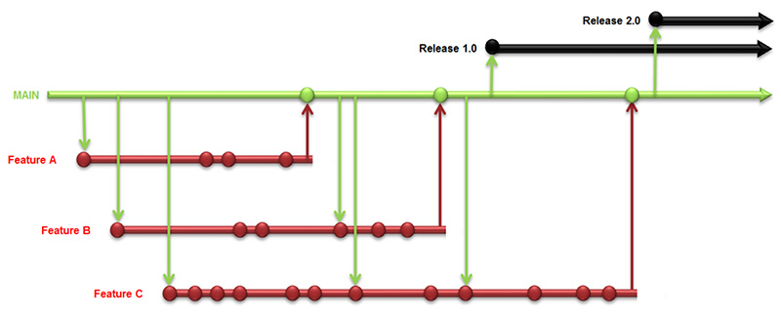
Build system basics
Definition
Example of Trunk and Branches

Slide 7
Build system basics
Components
There is a standard structure in SVN:
Root
trunk/branch
type – client, database, mobile
component – ComponentName
So a component path looks like:
software/trunk/server/ComponentName
software/branches/branchOne/ComponentName
The component level of the structure is also referred to as the code folder.
Notes:
This structure is mirrored in TeamCity. Great care was to taken to keep the structure the same to make components easy to find.

Slide 8

Build system basics
Basic Flow of a Build System
TeamCity Server: set parameters and choose build agent.
Build Agent: SVN checkout and compile
Build Agent: collect files needed for output.
Output Server: Move output packages from Agent to OutputServer for delivery.

Slide 9
Build system stats
By the Numbers
(Break down of number of and type of builds in the system)
Notes:
20 Onity/73 RealEstae

Slide 10
Build system basics
TeamCity VS Parabuild
As far as the general overview of how any build system works, Parabuild and TeamCity are the same.
So why the change?
Future expanded roll of our build system, to include automated testing and deployment.
Quicker response time to issues that are found. Changes can now be made in bulk, not individually by hand.
Quicker and more accurate branch build-outs.
Powerful database that backs up everything.
Transparency in the system. We can see the internal scripts TeamCity runs.
Vibrant Community to tap resources and troubleshoot with.

Slide 11
Build system basics
Why the pain?
While Parabuild and TeamCity do basically the same thing, we chose to do it in a different way.
Rewrite all scripts from Batch to PowerShell
Changes implemented in how the scripts operated
Desire to reduce number of scripts for easier maintenance
Tribal knowledge

Slide 12
Teamcity server
Basic Components of TeamCity
The primary purpose of the TeamCity server is to host a central place to manage the build system.
The TeamCity server supports the user interface and makes it available to all.
TeamCity tracks changes to the system:
SVN commits and revision numbers
Tracks agents and agent information
Tracks and maintains build configurations

Slide 13
Teamcity server
SVN Interaction
TeamCity monitors SVN connections by pinging the path every x seconds. It tracks changes to SVN and if a path is wrong it will throw errors.
(photo of error)
Notes:
Commits inside/outside code folder.

Slide 14

Teamcity server
Monitoring Agents
TeamCity constantly monitor's the build agents:
Is agent connected to TC server?
What is agent’s IP, name and host name?
Is agent authorized? (Licensing)
What software is installed on agent?
What components can build on this agent?
What pool does this agent belong to?
Is agent currently running a build?
What builds have run on this agent in the past?

Slide 15
Teamcity server
Monitoring Agents
(photo of monitoring page of one agent)

Slide 16
Teamcity server
Monitoring Agents
(photo of monitoring page of all agents)

Slide 17
starting a build
How a Build Starts
A build can be started three different ways.
Continuous integration is triggered by SVN check-ins to the code folder, or by a scheduled time.
Compile is run manually from the UI
Release is run manually from the UI if there are changes to compile.
(photo of component level home page)

Slide 18
Starting a build
Step 1
As soon as a build is kicked off, TeamCity server transfers all information needed to the Agent it is building on and runs the build as the user defined in the SVN checkout, likely a service account, not a personal account.

Slide 19


Starting a build
Step 1: Selecting a Build Agent
DB
Agent 3
Agent 85
Agent 32
VS10
Agent 34
TC
Agent 35
Agent 52
iOS
Agent 53
Agent 95
VS15
Agent 96
Agent 96
Server
Select agent pool
Select build agent

Slide 20
Starting a build
Step 1: Selecting an Agent
A pool is a group of one or more agents that are, ideally, created at the same time and have the same software installed.
It is critical that all agents in a pool are treated the same for the life of the pool.
When installing updates or otherwise making changes to a pool, it is best to use one agent in the pool and run test builds to be sure the changes don’t break the builds, thereby preserving the ability to create builds needed for releases.
Agent 84 – Needs software upgrade.
Agent 52
DB
iOS
Agent 85
Agent 53
Agent 95
Agent 32
VS15
VS10
Agent 96
Agent 34
Agent 97 – Broken.
Agent 35 – Down for testing.

Slide 21
Starting a build
Step 1: Selecting a Build Agent
Each of our components are paired with an agent pool, each pool has only the agents in that pool that are appropriate to build that component.
VS_2013 can build APIOne
Mobile pool can build iPhoneOne
Database can build DBOne
There are two spreadsheets I maintain. One is the current list of agents with associated pools, the other is the current list of components associated with pools.
iOS
DB
DBOne
Linux
APIOne
VS13
Server
Select agent pool

Slide 22
Starting a build
Step 1: Selecting a Build Agent
The build agent’s installed software must be compatible with the software the component needs to compile.
A VisualStudio component, like APIOne, must be built on an agent that has not only VisualStudio installed, but also the version of VisualStudio that CoreAPI was most recently edited on.
An iPhoneOne build must be built on a Mac that has Xcode 7 installed on it.
A database, such as, DBOne, must be built on an agent that has SQL and Red gate installed on it.
The software and agents used to compile must also be “pristine”. Free from any outside software that may make the build hard/impossible to recreate at a later time. For that reason, we do not install SLQ and AndroidStudio on the same machine, as an example.

Slide 23
Starting a build
Step 1: Selecting a Build Agent
Once the appropriate pool is chosen for a component, lets say VS_2013 is chosen to build CoreAPI, then an agent in the pool is selected for the actual build.
Agent 32
VS10
Agent 34
Agent 35
To build APIOne, a VS2013 component:
Agent 52
TC
iOS
Agent 53
Agent 95 – APITwo is currently building, agent is busy.
VS13
Agent 96 – Selected for APIOne build
Agent 97 – Currently off line.

Slide 24
Starting a build
Step 1: Selecting a Build Agent
Understanding this process, it becomes apparent how important the number and type of build agents are.
If there is only one agent in a pool, and something happens to that agent making it unusable, we are no longer able to build components of that type until such time a new agent is generated or the agent is fixed. Entire sections of our code base can not be built. This is where redundancy is important.
Only one build can be run at a time per agent. If there are 50 components that are assigned to a pool, then multiple agents are required to keep work flow from bottlenecking.
Ideally, we always have a minimum of two agents per pool for redundancy, and three agents for high demand pools.

Slide 25
Starting a build
Step 2: Setting Parameters
TeamCity sets the parameters to be used by the build agent.
Some parameters are auto populated by information that TeamCity acquires on it’s own, some parameters are set by the build configuration and can be edited.
(Photo of parameter list)

Slide 26
Starting a build
Step 3: Internal Scripts
After the parameters are set on the build agent, TeamCity internal scripts are run.
The first internal script checks out the most current SVN revision for that component on the build agent as well as the build scripts needed.
The build agent then runs each build step in order. Each type of build (VisualStudio, database, iOS) has it’s own number and type of build steps depending on the component’s needs.
The builds have been broken into segments since the move to TeamCity. Most now have a separate compile and release configuration.
(Photo of component level home configuration)
Notes:
The build steps are either runners that TeamCity provides (msbuild), or steps we have created using scripts.

Slide 27
Starting a build
Step 3: Internal Build Scripts
An internal build script is created by TeamCity for executing build steps.
(Photo of build steps editor page)

Slide 28
Starting a build
Step 4:External Scripts
Our old list of scripts to run builds:
(Photos of our old list of build scripts, with the blue highlight the ones that were n trunk x branch (hundreds!)
Notes:
The blue circle: We used to have a build.bat for every component. It was reduced to 14 prior to moving from Parabuild to TeamCity

Slide 29
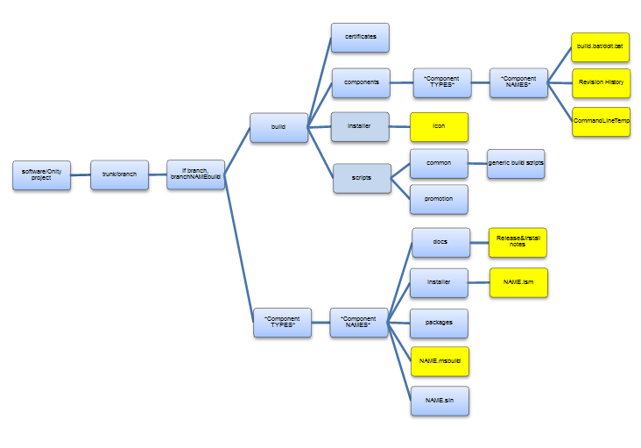
Build System basics
Old File Structure

Slide 30
Starting a build
Step 4: External Scripts
The new scripts used have been modified to capture as many builds as possible.
Currently, there is one compile and one release script covering most of each type of build. This is different from how we used to handle scripts. We previously had to have one script for every build. If there were changes to be made, every build would need a new script. Now we can make changes to all builds of a certain type by changing only one script.
(Photo of new script list, about 20 or so scripts to run things now. Gone are the individual scripts for every build.)
Notes:
Old structure vs new

Slide 31
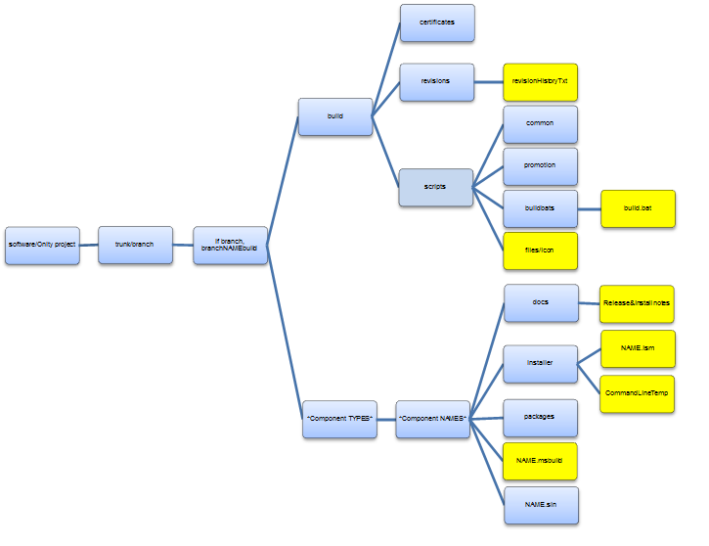
Build system basics
Fewer build.bat’s

Slide 32
Starting a build
Step 4: External Scripts
(Photo of the script)
This is the script that gets and sets the build version number that is used throughout the build.
Note how the parameters set earlier are used.
This is a classic case of trying to compensate for inconsistency in naming conventions in our code files. I must check for $TEAMCITY_PROJECT_NAME and $COMPONENT NAME because the outside project file does not always have the same name as the inside components. For example: ExConfig/ExConfiguration.sln

Slide 33

Starting a build
Anatomy of the Build System
Compile
Set build version number
Bring in DLLs if necessary
Compile
2. Test
Unit tests
Regression tests
3. Release
Create installer
Gather files
Package files
Move outputs to central location
4. Deploy
Daily?
Weekly?
When necessary?
Automatically!

Slide 34
Compile
Overview
TeamCity allows us to use templates for the build steps. For example, nearly all components that use VisualStudio 2013 can use the same template. This allows changes to all VS 2013 builds at the same time that are attached to the template if changes are necessary.
(Photo of build steps)

Slide 35



Compile Visual Studio
Visual Studio Step 1: Set Version Number
A short script runs that reads the first three numbers in our version file, then adds the build number as the fourth number.
%build_number%
4
1.2.3.4
1.2.3
Once the two pieces of information are concatenated, the parameter %env.BuildVersion% is set to reflect the complete version number and passed through the remainder of the build process.

Slide 36


Compile
Visual Studio Step 2: Get DLLs
Many builds need DLL packages or other outside resources to build properly.
In TeamCity these are referred to as dependencies. TeamCity makes it easier to only import the packages we need for individual builds, instead of all packages for all builds.
Shared Folder
EULA
DLL
Pack1
Component
Code Folder
DLL
Pack2

Slide 37
Compile
Visual Studio Step 3: Compile
We are ready to compile.
The MSBuild file is called and part of the sequence picks up the %BuildVersion% and injects it into the build (through a variable in .msbuild. MSBuild then compiles the code down to binaries for later use by creation of the installer in the release step.

Slide 38
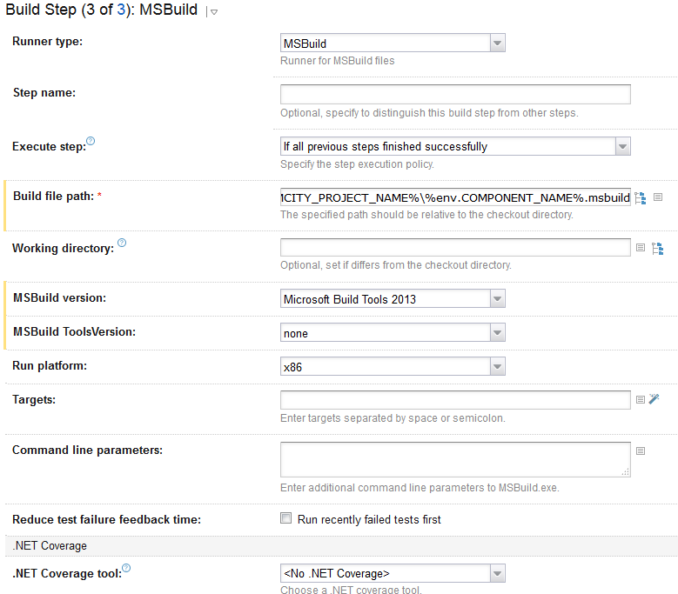
compile

Slide 39
Compile
Database
Databases check out the current SVN revision to what we refer to as a “source file.”
Databases then also check out a copy of the database that we comparing to. This can be an older SVN revision or a working database on one of our servers in DEV, QA, or Staging. We put this in a file called “TEMP” and refer to it as the target database.
A sequence of schema and data compares are performed that produce new .slq scripts, as well as any other scripts needed for the deploy and rollback.
Notes:
(Checked out by kcbuilder from the command line.)

Slide 40
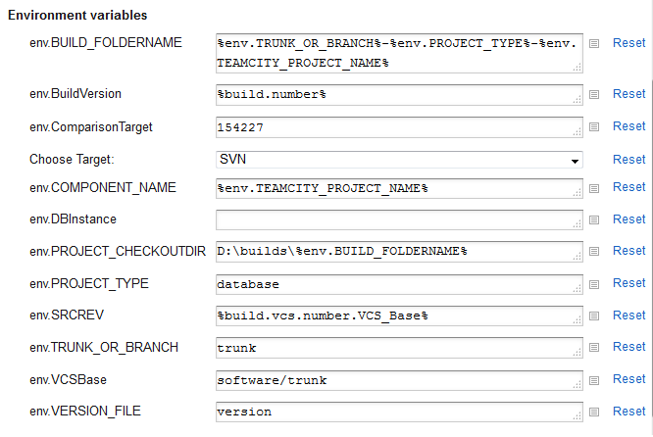
Compile
Database

Slide 41
Compile
Mobile
Android builds are compiled using Android Studio from the command line. Important note: During the build Android Studio goes out to the internet and downloads packages it needs for that specific build.
iOS builds use either Xcode 7 or 8, depending on the age of the component. iOS builds must also reach the internet from the command line to perform all of the functions of the build.
Both Android and iOS builds, at the end of the compile sequence “push” the build up to Fabric. Fabric is used as a second output storage solution that QA and Silver Pine can access, as well as for automated testing.

Slide 42
Compile
Other Types of Builds
There are a few other builds that don’t fit neatly into one of the above categories. They are dealt with on an individual basis.
Delphi
In Rad Studio
Debian
Unbuntu

Slide 43
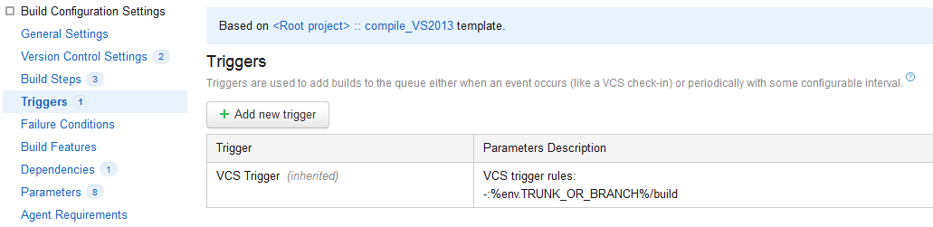
Testing
Coming Soon!
We have purposely set TeamCity up to accommodate an automated testing phase into our build process.
We can set a trigger to automatically run tests after the compile completes.
This is called chaining builds. TeamCity knows when a build configuration (like compile) is complete and looks for a trigger.

Slide 44
Triggers
Why Are They Important?
We have already seen a couple examples of triggers. Triggers can be used to chain builds together when a fluid sequence is important or for starting a build process.
Types of triggers:
VCS (SVN) trigger: When there are changes detected in our SVN repository in the files that we choose to watch.
  Scheduled trigger: Schedule for daily or weekly runs of a configuration.
  Finish Build trigger: When a build of a selected configuration is finished it triggers the next step. When compile is finished test is triggered and run.

Slide 45
Release
When is it run?
Currently this is a manual process as far as clicking the run button. We don’t want to run the release every time compile is run, or we would be producing an excess number of build outputs in our storage. We only run the release configuration when we need outputs.
Release builds are dependent on the compile phase. We use what TeamCity refers to as a “snapshot dependency.”
Release will only run if there is a “suitable” build.
We have configured the dependency to only run on the machine that compile was run on, so compile and release source code is exactly the same on the same machine.
Notes:
No changes in SVN, same source code, successful compile, no customized parameters, no changes to configuration

Slide 46
Release
Official or Unofficial?
We create Official and Unofficial builds.
Unofficial builds should be used whenever possible. They are purged from our storage after 180 days.
Official builds should be used if a component is going to QA or being deployed or released. Official builds are kept forever.
Considerations for keeping builds:
Conservation of storage on BuildMaster
CI increases amount of builds created (compiles) this is one reason why the separation of compile and release.
CI increases amount of builds, could bottle neck the system

Slide 47
Release
Visual Studio Step 1: Install Shield
An installer gathers files needed and compiles it down to binaries to work on multiple platforms.
%BuildVersion% picked up from compile
Types: IIS, 64 vs 32, RefreshConfig
MSI vs EXE
Naming conventions are important here as well!
Notes:
Maybe move it to compile Importance of installers

Slide 48
Release
Visual Studio Step 2: Create BOM
This step creates the BOM directory and moves files around.
Move files to BOM for
Copy and rename Installer
Create command line template
Move install and release notes
Add identifying tag to files names.
Logs

Slide 49
Release
Visual Studio Step 3 - 5: Final Steps
Step 3: Archive Release:
Move all contents of BOM into folder on to server that holds the build outputs and if it’s flagged as official, zip and include code folder in the outputs.
Step 4: Move Logs:
Wait until end so logs are as complete as possible.
Step 5: Bill of Materials:
Very last step to make URLS as easy to find as possible.
Notes:
May move up above LOGS.

Slide 50
Release
Database Releases
Database releases follow a specific set of steps due to the constraints of snapshot dependencies in TeamCity. We have developed a standard of work to accommodate the constraints involving “promote”.
The rest of the release steps are very similar to Visual Studio steps, but disregarding the Install Shield step.

Slide 51
release
Database
(Photo of database build steps)

Slide 52
Release
Database
(Photo of specific DB parameter list)

Slide 53
Deploy
On its Way!
In the future we plan on moving toward automated deployment.
We will likely start with a manual process and move toward automation.
Like the compile and test build chain, release and deploy will be chained together as well.
Notes:
Stop here

Slide 54
Stop here

Slide 55
Corporate responsibility
How do we minimize our footprint?
Reduce kept builds
Return old servers

Slide 56
Problem areas
Branches don’t match trunk if changes to trunk after branch is made.
Database builds
Need more agents.

Slide 57
Notes
CI increases amount of builds created (compiles) this is one reason why the separation of compile and release.
CI increases amount of builds, could bottle neck the system without more agents
Service Account – Important!
Dependency between compile and release

Slide 58
Starting a build
Step 1
As soon as a build is kicked off, TeamCity server transfers all information needed to the Agent it is building on and runs the build as the user defined in the SVN checkout, likely a service account, not a personal account.

